Slide 1


Energy Consumption Analysis
A ENERGYDB2 Database using MySQL
Presented By:
Thota Naga Vedasree

Slide 2
Meet The Team
Thota Naga Vedasree
Background : B. Tech – CSE
Why Data Science? I interested to working with data and solving problems using analytical thinking.
Work Experience : Fresher
LinkedIn : http://www.linkedin.com/in/naga-vedasree-thota- 056388279
GitHub : https://github.com/nagavedasreethota012-lgtm

Slide 3
AGENDA
Objective of the Project
ER Diagram and Schema Explanation
Key analysis questions
Conclusion
Challeneges / Experience

Slide 4
Objective of the Project :
Analyze energy consumption and production across different countries.
Identify countries with the highest emissions and GDP.
Study global emission and energy trends over time.
Calculate energy consumption and production per capita.
Analyze the relationship between GDP, population, energy use, and emissions.
Compare countries using emission-to-GDP and consumption-to-GDP ratios.
Generate meaningful insights from the data to support better understanding and decision-making.

Slide 5
INTRODUCTION:
The Energy Consumption project analyzes energy-related data for different countries using SQL. The dataset contains information about energy consumption, energy production, emissions, GDP, and population. These datasets are organized into six related tables in a MySQL database.
The project uses SQL queries to compare countries, analyze changes over time, calculate per-capita measures, and understand the relationship between economic activity, population, energy usage, and emissions. The analysis helps identify important global energy patterns and provides meaningful insights for better understanding of energy consumption and environmental impact.

Slide 6
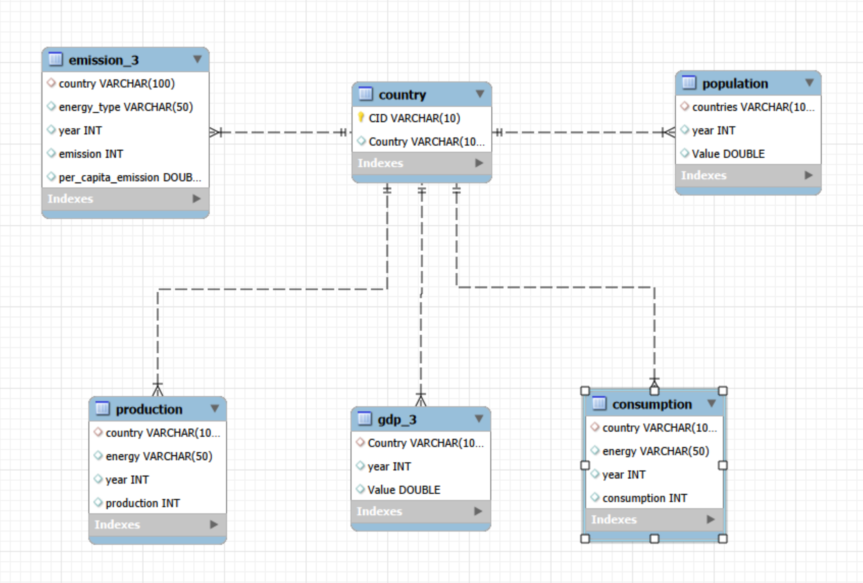
ER Diagram

Slide 7
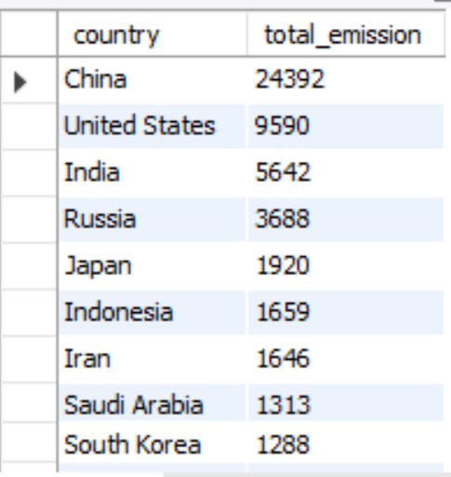
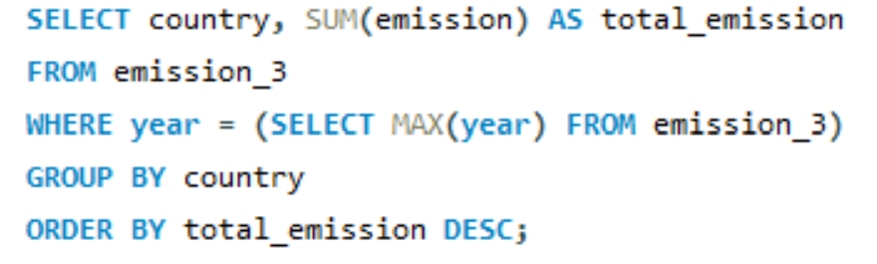
Analysis Questions
1. General & Comparative Analysis
What is the total emission per country for the most recent year available?
QUERY:
OUTPUT:
Key Insights:
China has the highest total emissions (24,392), far ahead of the United States (9,590).
India ranks third with 5,642 emissions, followed by Russia with 3,688.
The top few countries contribute a large share of the total emissions, indicating significant concentration among major economies.

Slide 8
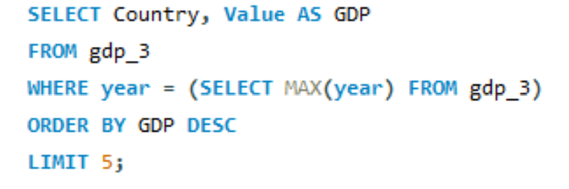
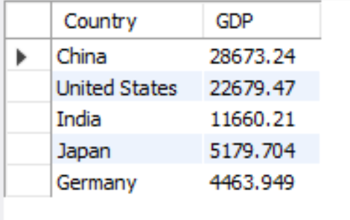
What are the top 5 countries by GDP in the most recent year?
QUERY:
OUTPUT:
Key Insights:
China has the highest GDP (28,673.24), followed by the United States (22,679.47).
India ranks third with a GDP of 11,660.21, significantly ahead of Japan and Germany.
The top 5 countries show that China and the United States dominate the GDP ranking in this dataset.

Slide 9
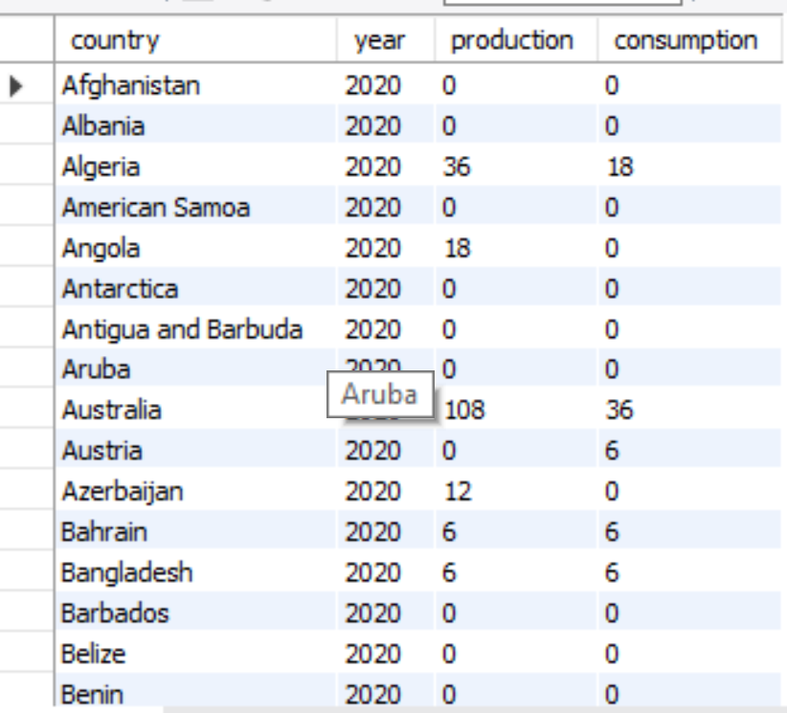
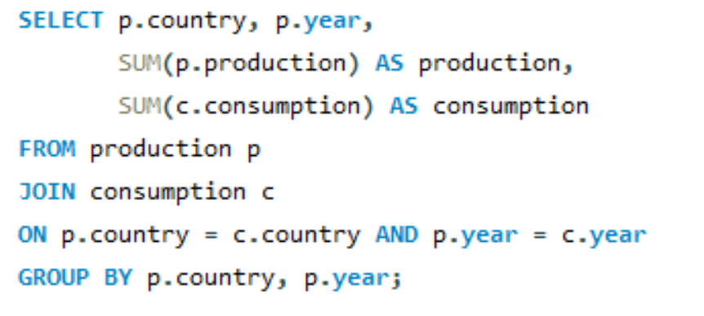
Compare energy production and consumption by country and year.
QUERY:
OUTPUT:
Key Insights:
Australia has the highest production (108) among the countries shown, with consumption of 36.
Algeria produces 36 and consumes 18, showing production is higher than consumption.
Several countries such as Afghanistan, Albania, and Barbados have zero production and consumption in the displayed data.

Slide 10
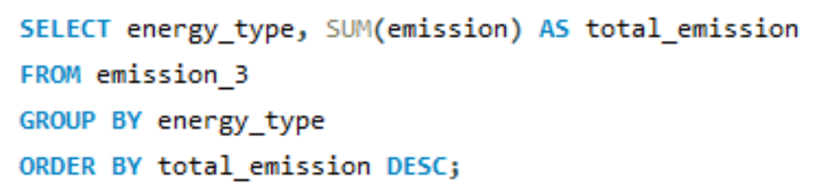
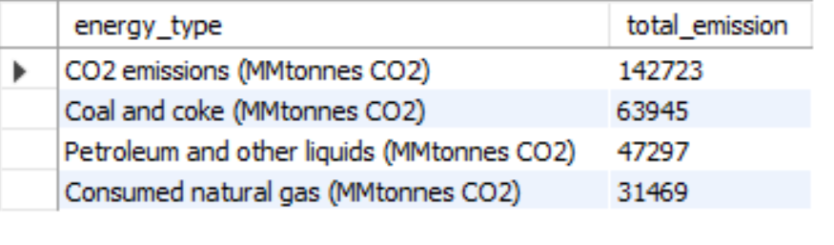
Which energy types contribute most to emissions across all countries?
QUERY:
OUTPUT:
Key Insights:
CO₂ emissions have the highest total at 142,723, making them the largest emission category.
Coal and coke contribute 63,945, followed by petroleum and other liquids at 47,297.
Consumed natural gas has the lowest total at 31,469 among the categories shown.

Slide 11
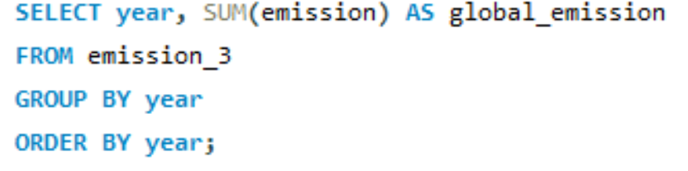
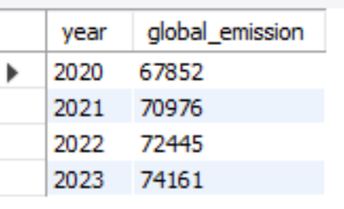
How have global emissions changed year over year?
2. Trend Analysis Over Time
QUERY:
OUTPUT:
Key Insights:
Global emissions increased every year, from 67,852 in 2020 to 74,161 in 2023.
Emissions increased by 6,309 overall, showing a clear upward trend.
2023 recorded the highest global emissions, while 2020 had the lowest.

Slide 12
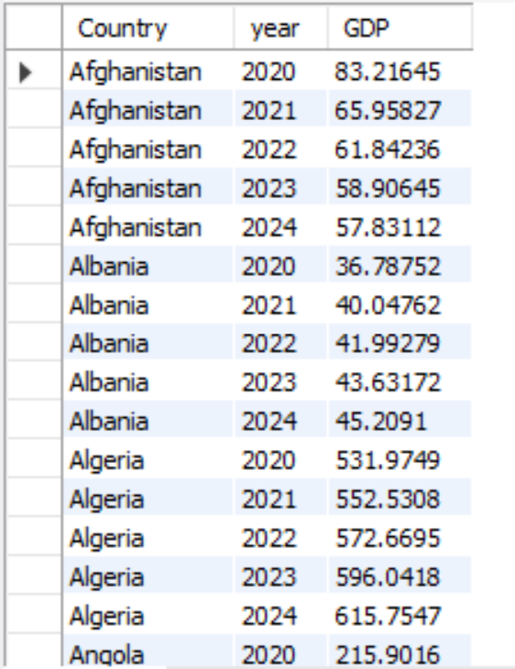
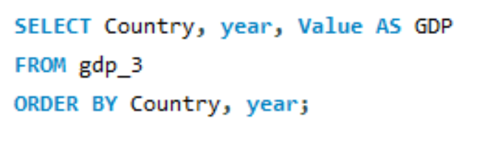
What is the trend in GDP for each country over the given years?
QUERY:
OUTPUT:
Key Insights:
Afghanistan’s GDP decreased from 83.22 in 2020 to 57.83 in 2024, showing a continuous decline.
Albania’s GDP increased from 36.79 in 2020 to 45.21 in 2024, showing steady growth.
Algeria showed strong GDP growth, increasing from 531.97 in 2020 to 615.75 in 2024.

Slide 13
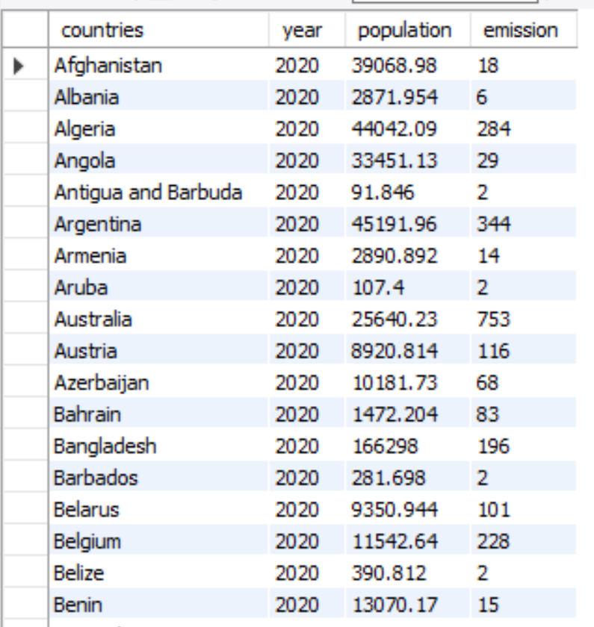
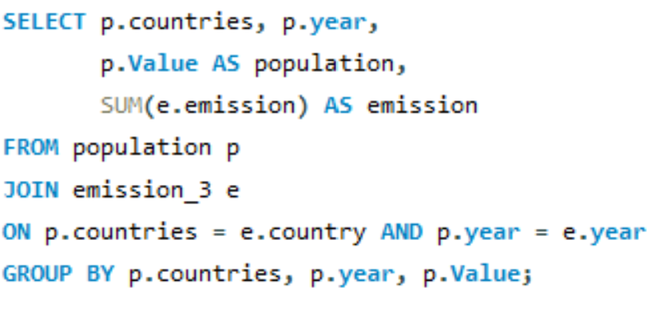
How has population growth affected total emissions in each country?
QUERY:
OUTPUT:
Key Insights:
Argentina has the highest population shown (45,191.96) and also high emissions (344).
Australia has relatively lower population (25,640.23) but higher emissions (753), indicating high emissions relative to population.
Bangladesh has the highest population shown (166,298) but emissions of 196, showing that a larger population does not necessarily mean higher emissions.

Slide 14
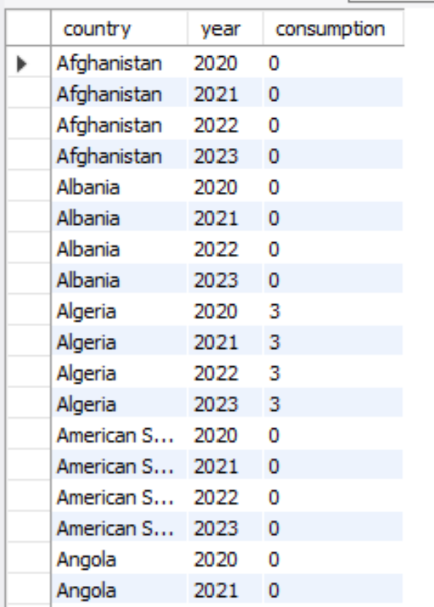
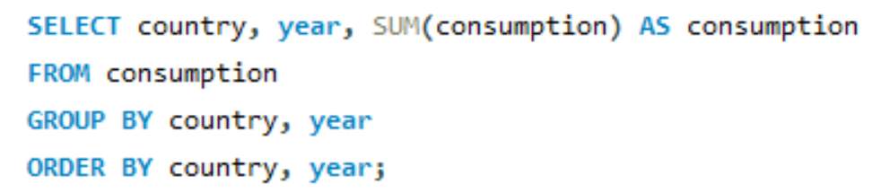
Has energy consumption increased or decreased over the years for major economies?
QUERY:
OUTPUT:
Key Insights:
Algeria’s energy consumption remained stable at 3 from 2020 to 2023.
Afghanistan and Albania recorded 0 consumption across the years shown.
Overall, the displayed data shows very low or zero consumption for several countries, while Algeria shows consistent consumption over time.

Slide 15
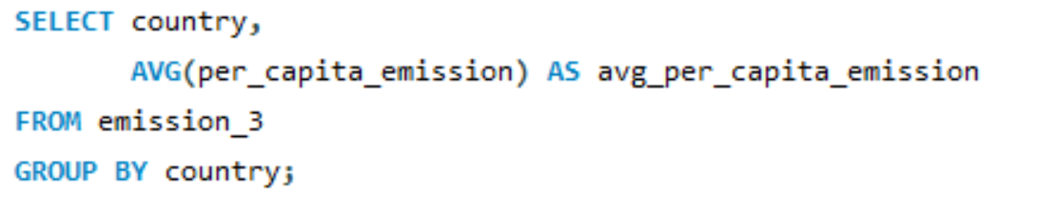
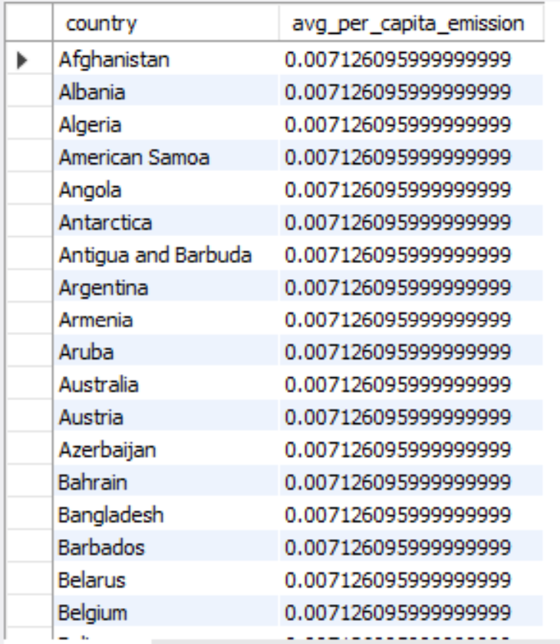
What is the average yearly change in emissions per capita for each country?
QUERY:
OUTPUT:
Key Insights:
The average per-capita emission is identical (~0.007126) across all countries shown.
This suggests the data may have a calculation, grouping, or aggregation issue that needs to be checked.

Slide 16
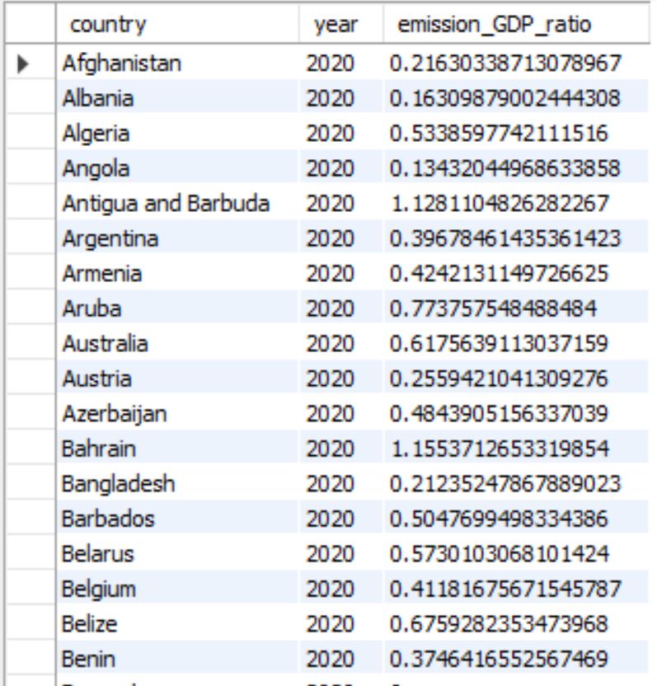
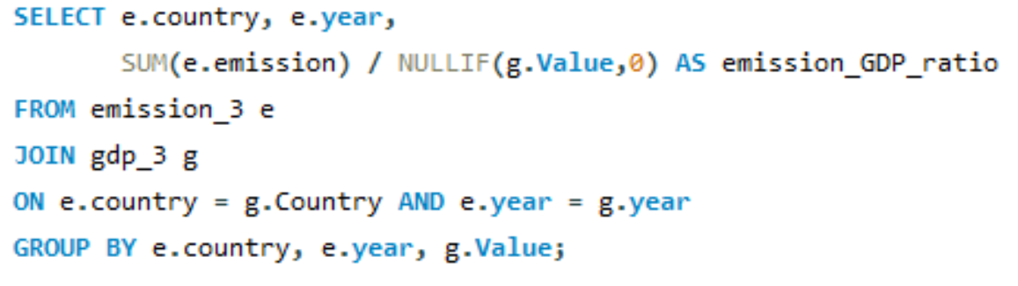
3. Ratio & Per Capita Analysis
What is the emission-to-GDP ratio for each country by year?
QUERY:
OUTPUT:
Key Insights:
Emission-to-GDP ratios vary significantly across countries in 2020, indicating different levels of carbon intensity.
Bahrain and Antigua & Barbuda show relatively high ratios, while Albania and Angola have lower ratios among the countries shown.

Slide 17
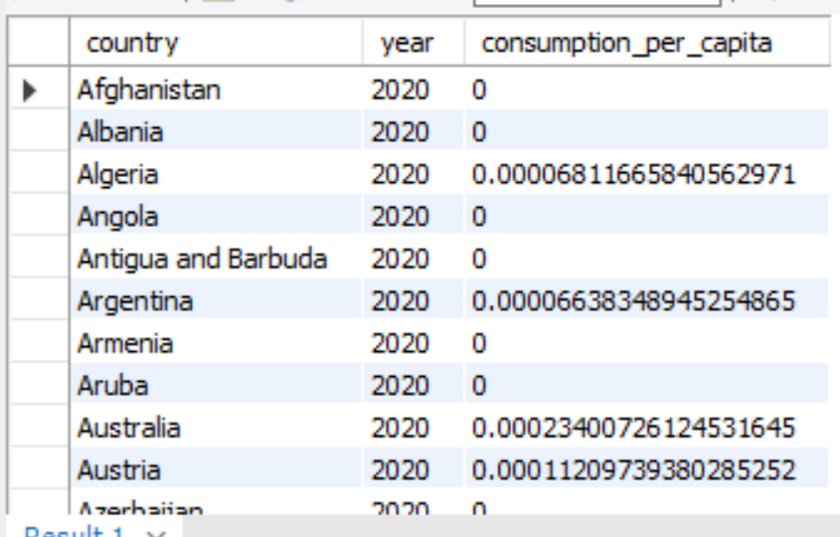
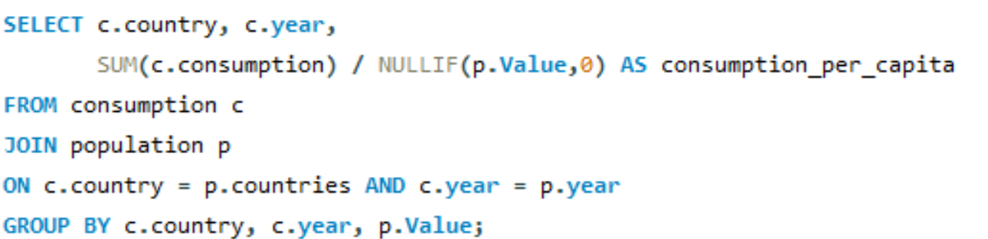
What is the energy consumption per capita for each country over the last decade?
QUERY:
OUTPUT:
Key Insights:
Per-capita consumption is very low for most countries shown, with many values recorded as zero.
Australia has the highest consumption among the visible countries, followed by Austria and Algeria.

Slide 18
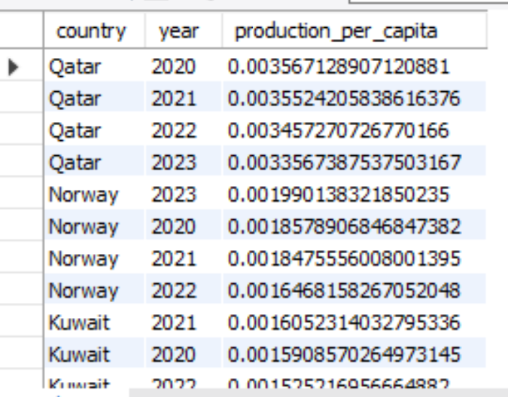
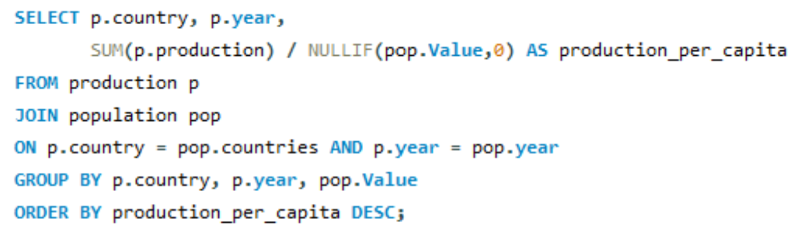
How does energy production per capita vary across countries?
QUERY:
OUTPUT:
Key Insights:
Qatar has the highest production per capita among the countries shown, though it slightly decreases from 2020 to 2023.
Norway and Kuwait also show relatively high production per capita, with Norway showing a noticeable decline over time.

Slide 19
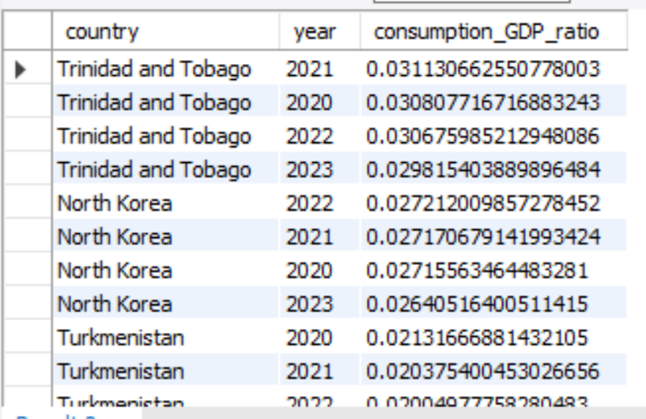
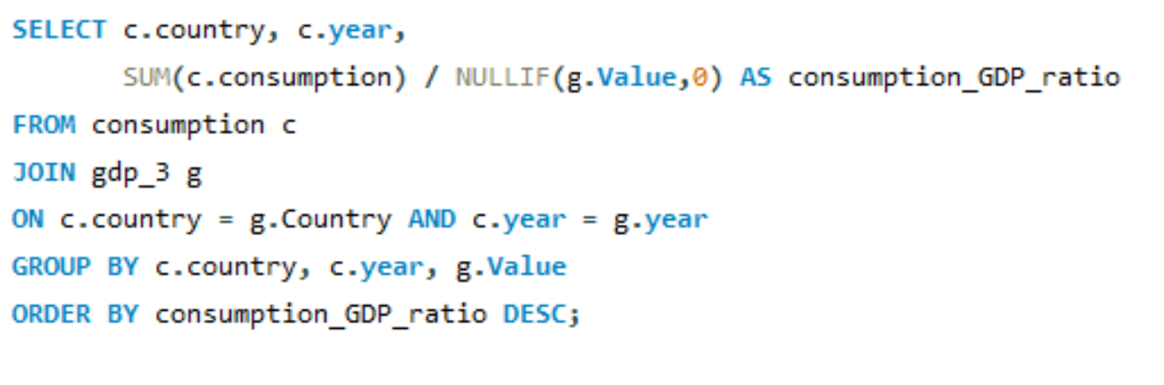
Which countries have the highest energy consumption relative to GDP?
QUERY:
OUTPUT:
Key Insights:
Trinidad and Tobago has the highest consumption-to-GDP ratio, but it steadily declined from 2020 to 2023.
North Korea and Turkmenistan also show a gradual decreasing trend over the years.
Overall, consumption_GDP_ratio is declining across the countries shown.

Slide 20
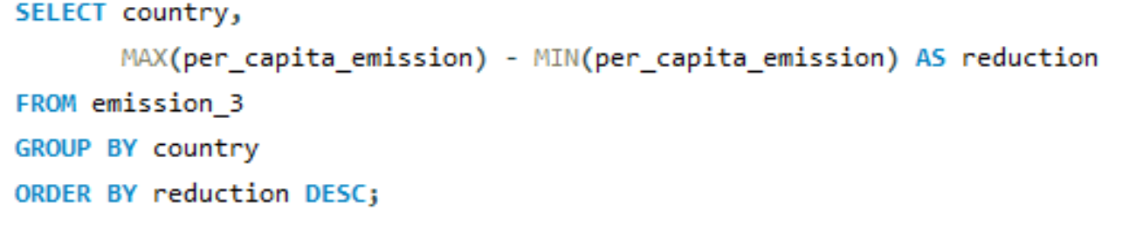
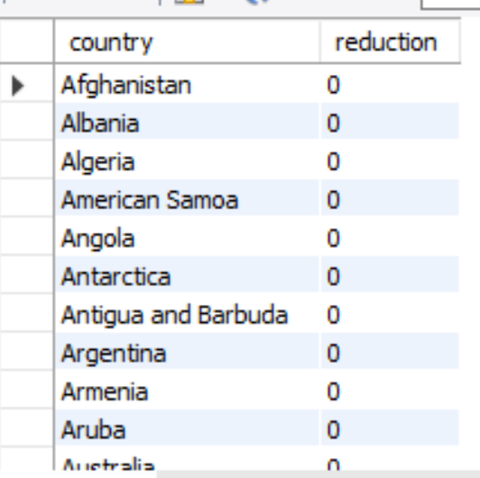
4. Global Comparisons
Which countries have improved (reduced) their per capita emissions the most over the last decade?
QUERY:
OUTPUT:
Key Insights:
The reduction value is 0 for all countries shown, indicating no reduction in the measured metric.
This suggests no significant change/reduction across these countries in the displayed data.

Slide 21
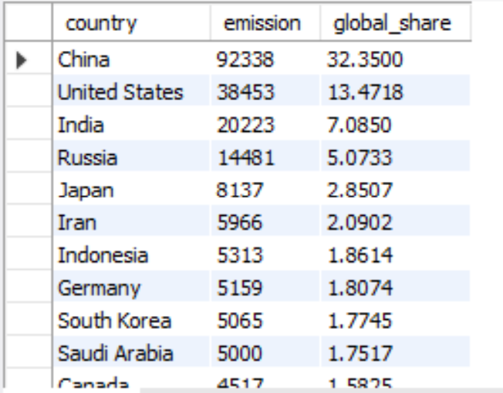
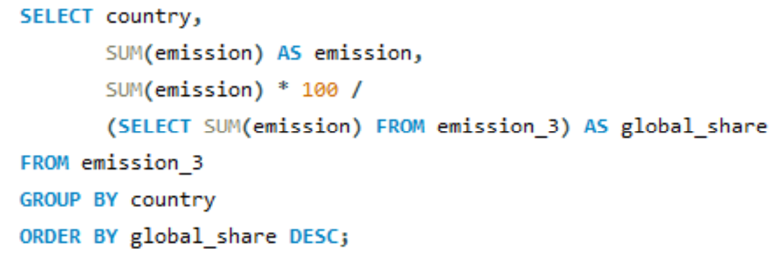
What is the global share (%) of emissions by country?
OUTPUT:
QUERY:
Key Insights:
China is the largest emitter, contributing 32.35% of global emissions.
The United States (13.47%) and India (7.09%) follow, making them the next-largest contributors.
The top 3 countries together account for over 50% of global emissions.

Slide 22
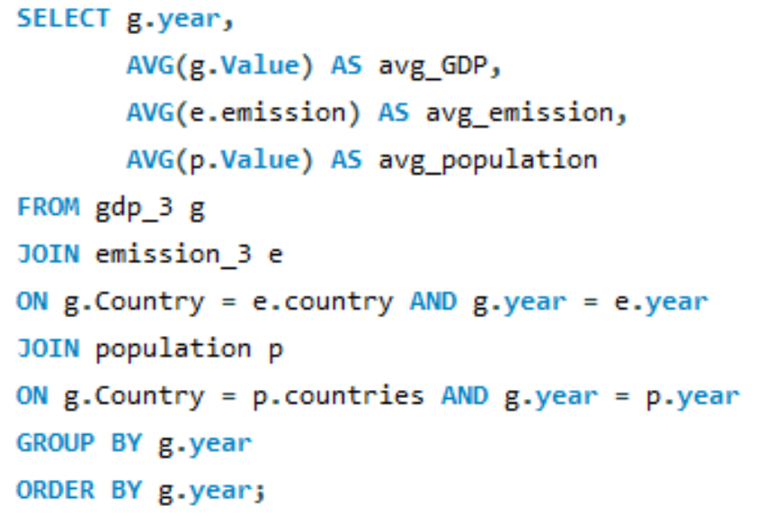
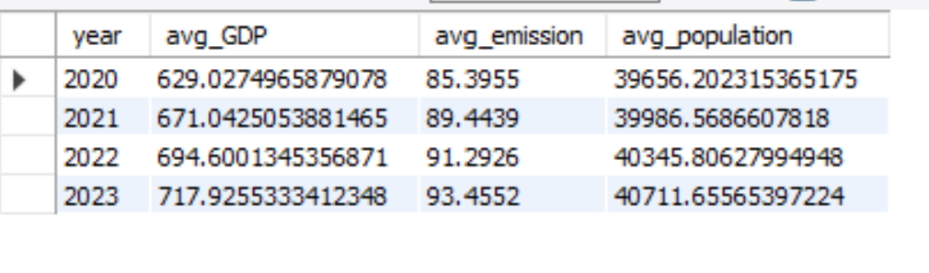
What is the global average GDP, emission, and population by year?
QUERY:
OUTPUT:
Key Insights:
Average GDP, emissions, and population increased steadily from 2020 to 2023.
GDP increased from 629.03 to 717.93, while average emissions rose from 85.40 to 93.46.
Population also grew gradually, showing an overall upward trend across all indicators.

Slide 23
Experience/Challenges:
Gained practical experience in MySQL and SQL data analysis.
Learned to work with multiple related tables using Primary Keys and Foreign Keys.
Used SQL JOINs, GROUP BY, aggregate functions, subqueries, and filtering for analysis.
Developed meaningful insights from structured data to support data-driven decision-making.
Understanding relationships between the six tables was challenging initially.
Handling different years and matching country records across tables required careful use of JOIN conditions.
Calculating ratios such as emission-to-GDP and per-capita values required careful handling of zero or missing values.
Some analysis questions had multiple possible SQL approaches, so choosing the most appropriate query was challenging

Slide 24
Conclusion:
I had Successfully analyzed global energy consumption and production.
Compared GDP, population, and emissions across countries.
Identified important energy and emission trends over time.
Calculated per-capita and GDP-based ratios.
Used SQL to generate meaningful data-driven insights.
The project improved practical SQL and data analysis skills.

Slide 25

THANK YOU

